Slide 1

Housing Project
Bao Ngoc (Jane) Dinh
Yonglin Liu
Chenhui (Cedric) Li
Xinyue Chen

Slide 2
Problem Statement
The housing market has so much information. For the average buyer/seller, it can be hard to quantify those housing data into “How much is this house worth?”
With data on historical sale of houses, we hope to build a model that can predict the Sale Price of a house based on the house’s quality and characteristics.

Slide 3
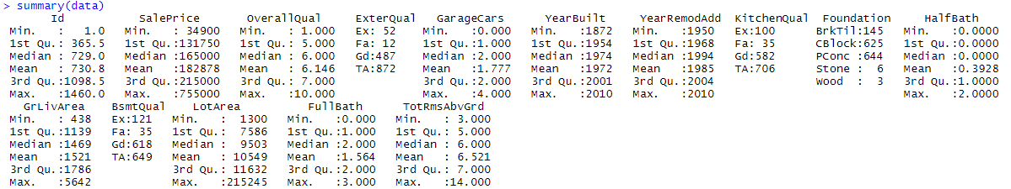
Summary Statistics
There exists a big difference between minimum and maximum value for variables like: GrLivArea, Lot area and SalePrice
We would like to investigate them further in our Initial Plots

Slide 4
Feature Development
Overall quality variable: changed the data type to numeric
Calculated the years since the original construction date and since the remodel date for each house by using the YearBuilt and YearRemodAdd variables
Dropped outliers below 1st and above 99th percentile for variables SalePrice, GrLivArea, Lot Area

Slide 5
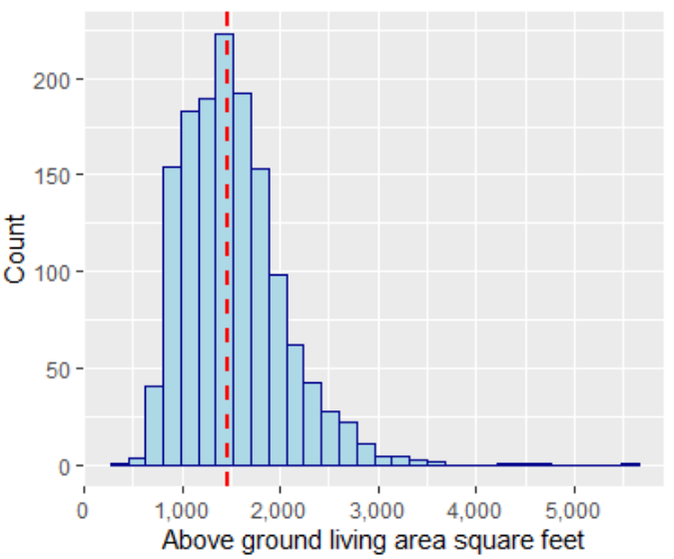
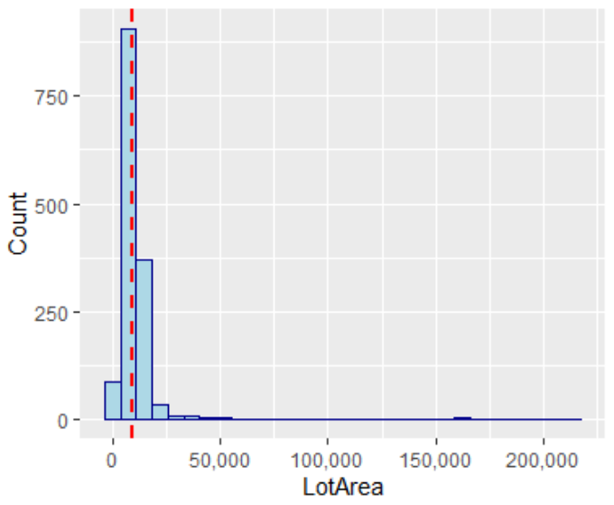
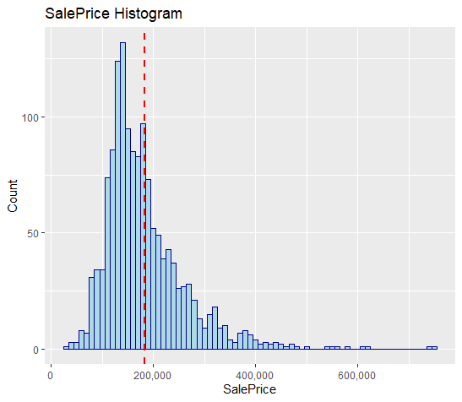
Initial Plots
These variables are all right-skewed

Slide 6
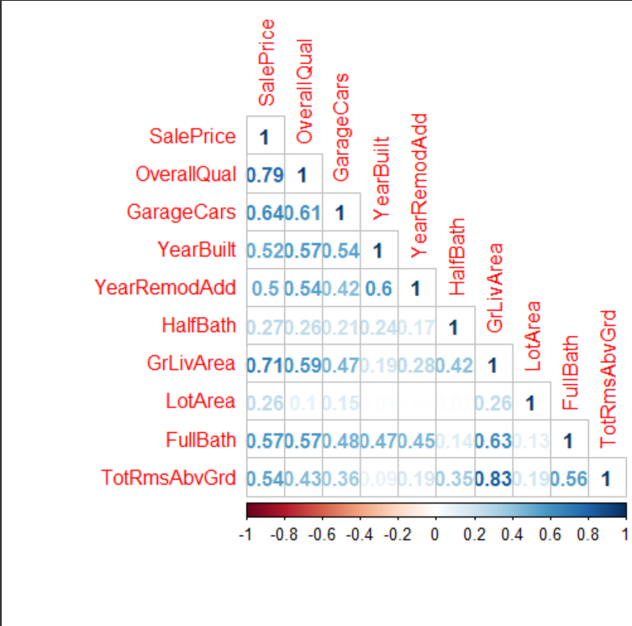
Initial Plots
Variables that correlate well with SalePrice were:
GarageCars
YearBuilt
GrLivArea
FullBath
OverallQual
TotRmsAbvGrd

Slide 7
Hypothesis
Not all variables will be important or significant in predicting sale price (needs further analysis through p-value test…)
Variables that correlate well with sale price in the corrplot could be the important variables to predicting the sale price
Some of our variables will have multicollinearity issues (quality-related variables)

Slide 8
Linear Regression Model 1
Make a training and testing set with 70% : 30% partition
Split on Sale Price
First built a full model with all variables of interest:
Overall Quality
External, Kitchen, and Basement Quality
YearSinceRemod (derived from YearRemodAdd)
Age (derived from YearBuilt)
GrLivArea, TotRmsAbvGrd
Garage Cars
Foundation
HalfBath, Full Bath

Slide 9
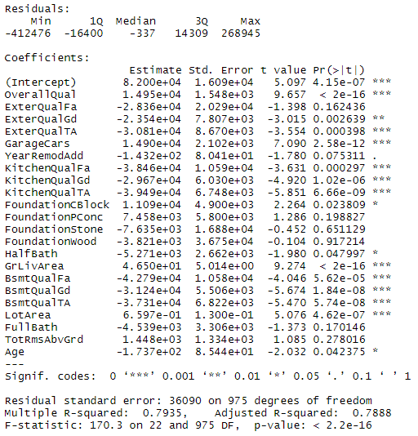
Full Model Summary Output
Coefficient estimate of OverallQual: 14,950
Adjusted R-squared: 78.9%
Most variables are statistically significant
Foundation, FullBath, and TotRmsAbvGrd have a p-value larger than 0.05

Slide 10
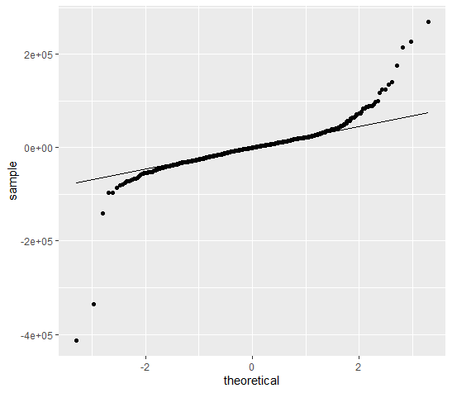
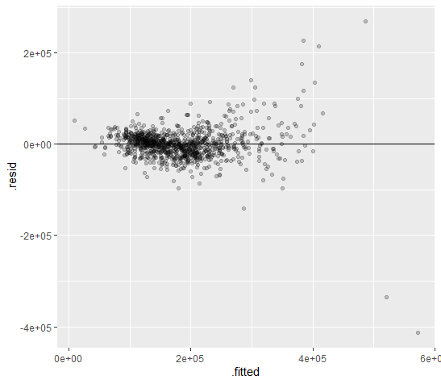
Assumptions for Model 1
QQ plot showed some non-normality of the residuals
Residual plot shows non-constant variances of residuals
The linearity assumption is met

Slide 11
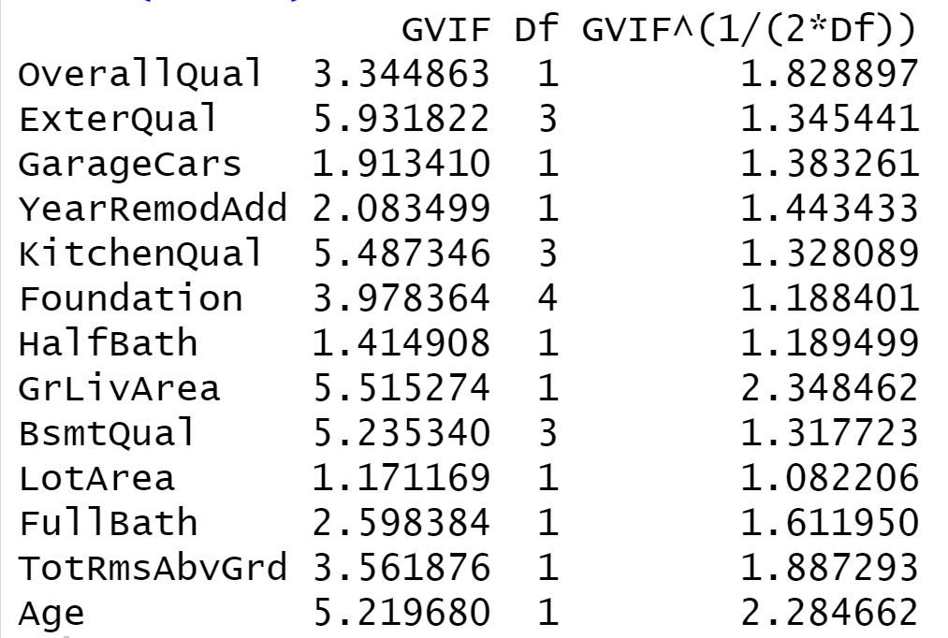
Dealing with Multicollinearity
No variables have a strong collinearity for VIF above 10
Five variables with VIF higher than five signal the problem
Removing those variables from the model individually and altogether

Slide 12
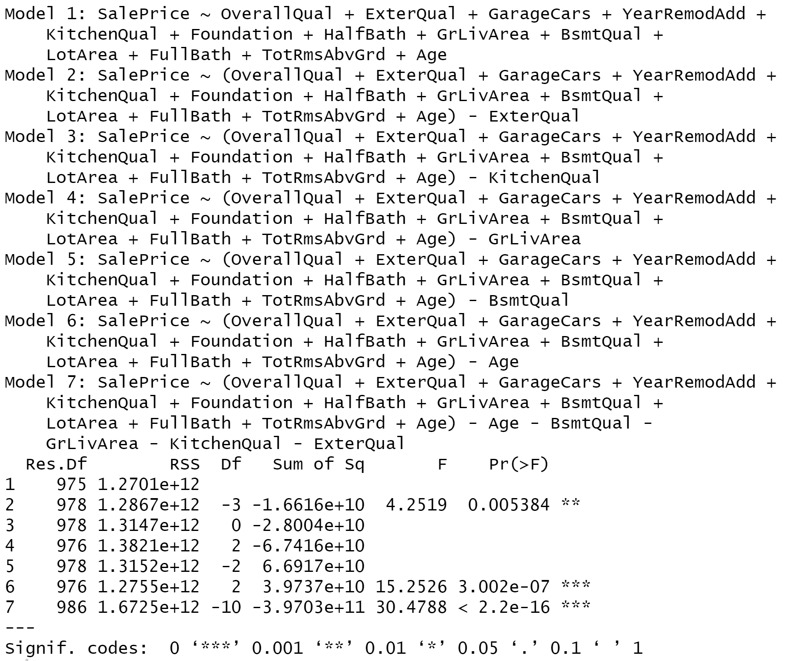
Comparing Full and Nested Models

Slide 13
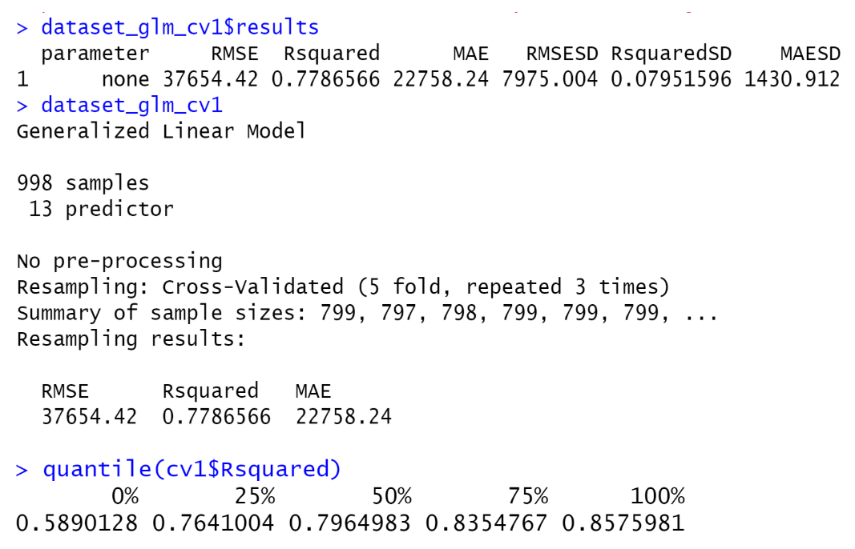
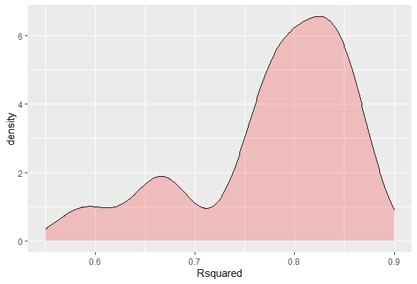
Model 1 K-fold Cross Validation
Five folds repeated three times
In general, we expect the R-squared for model 1 is 77.9%, RMSE of 37654 and MAE of 22758
R-squared ranged from 58.9% to 85.76%, with a medium of around 79.6%

Slide 14
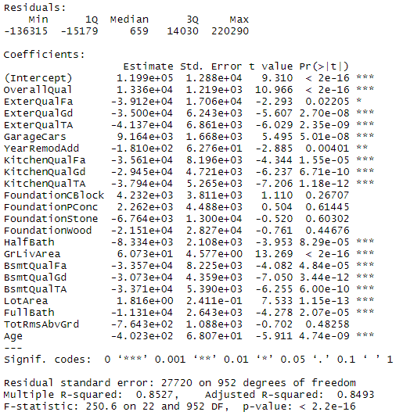
Linear Regression Model 2
Intercept shows the base value is $119900
Quality of the Material on the Exterior has the largest coefficient
Above Ground Living Area has the smallest coefficient
Foundation and Total Rooms Above Grounds are not significant at 95% level

Slide 15
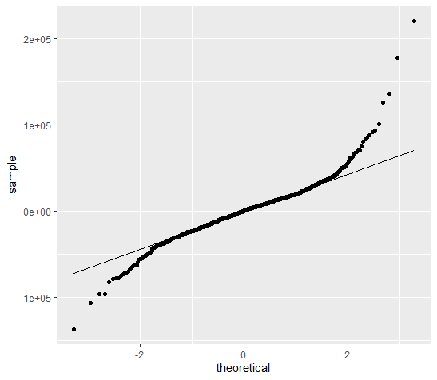
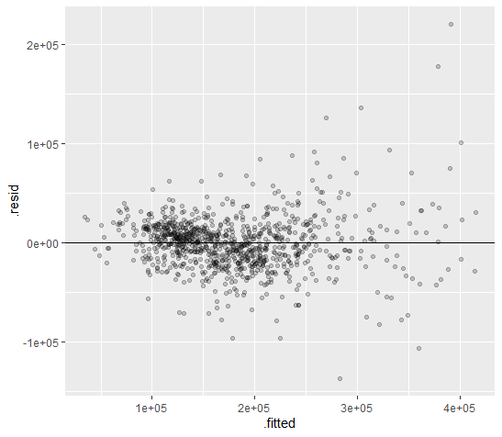
Linear Regression Model 2

Slide 16
Model 2 Cross Validation
Model | RMSE (Validation) | R-square (Validation)
Linear Regression 2 | 32944.57 | 0.835925
Linear Regression 2 (CV) | 28183.38 | 0.844422
n-fold = 5 & repeat = 3
Linear Regression Model with cross validation has better performance

Slide 17
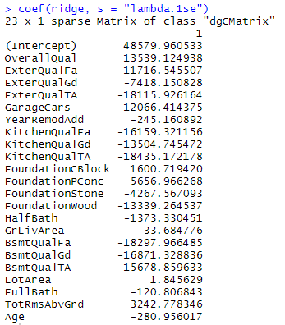
Ridge Regression
Intercept shows the base value is $48580
Typical/Average Kitchen Quality has the largest coefficient
Size of Lot has the smallest coefficient

Slide 18
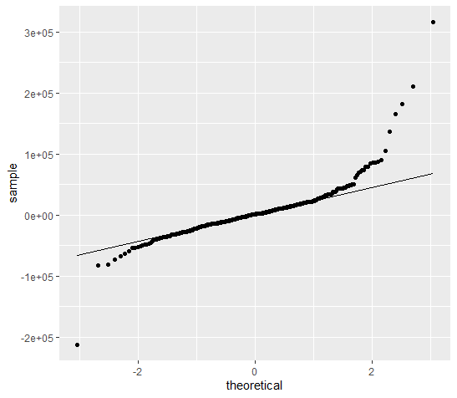
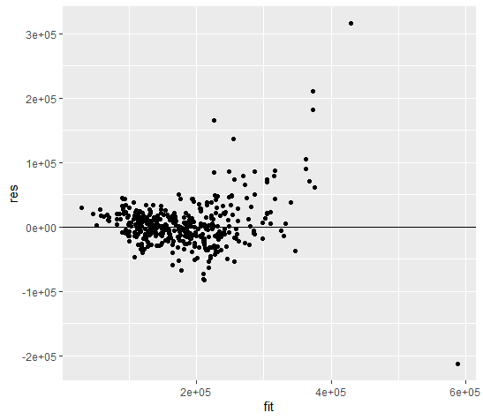
Ridge Regression

Slide 19
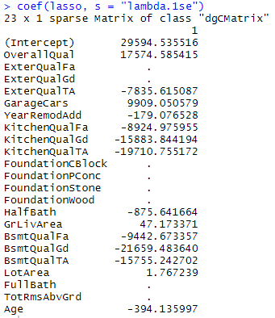
Lasso Regression
8 variables are eliminated
Intercept shows the base value is $29595
Basement Quality has the largest coefficient
Size of Lot has the smallest coefficient

Slide 20
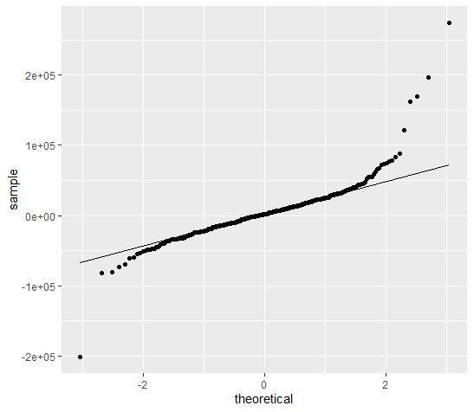
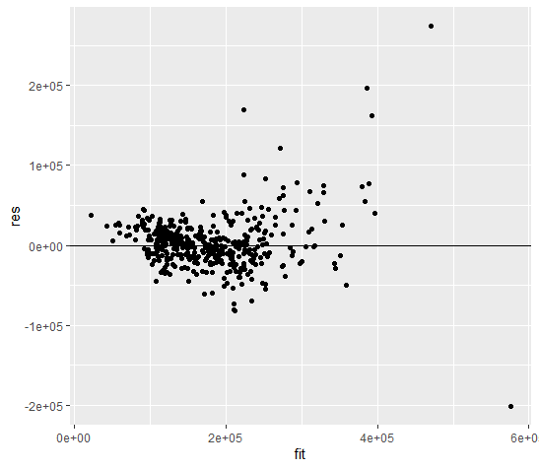
Lasso Regression

Slide 21
Model Comparison
Model | RMSE (train) | RMSE (test) | R-square (train) | R-square (test) | Variance of R-square
Linear Regression 1 | 35673.73 | 33389.20 | 0.7935 | 0.8315 | 0.038
Linear Regression 2 | 27391.99 | 32944.57 | 0.8527 | 0.8359 | -0.0168
Ridge Regression | 30183.89 | 37545.60 | 0.8212 | 0.7869 | -0.0343
Lasso Regression | 29564.94 | 35677.49 | 0.8285 | 0.8076 | -0.0209
Model | RMSE (Validation) | R-square (Validation)
Linear Regression 1 (CV) | 37654.42 | 0.7787
Linear Regression 2 (CV) | 28183.38 | 0.8444

Slide 22
Conclusion and Limitation
Conclusion:
Linear regression model without outliers is our robust model.
Kitchen quality, height of the basement, and quality of material on the exterior are prominent variables that contribute to the difference of sale price.
Limitation:
Limited to the fields of linear regression models
Limited by external validations

